Slide 1


Fantastic elephants and where to find them
Project Pink Elephants
Group 1 –
Berill Varga, Stefan Lilja & Jinshu Pan
Notes:
Gruppens profiler:

Slide 2

The issue - sustainable eco system
Endangered species
Animal poaching = bad (and sad)
Track sick animal/animal in distress
According IUCN, about 26,500 endagered species exist in just Africa
IUCN = Int’l Union for Conservation of Nature
Notes:
Target group:
Animal protection services/organizations, i.e. WWF
Tourism industry, i.e. Safari expeditions
IUCN = Internationella naturvårdsunionen

Slide 3
Dataset & Demo
Our dataset
Loxodonta Africana/African bush elephants
Resides within the Kruger nat’l. park
Notes:
Loxodonta africana - eller savannelefanten som det heter på svenska. Är en utrotningshotad djurart pga. Förlorade livsmiljöer och tjuvjakt för kött samt elfenben.
Grupperna som vi har valt att fokusera på har en residens i östra Sydafrika

Slide 4
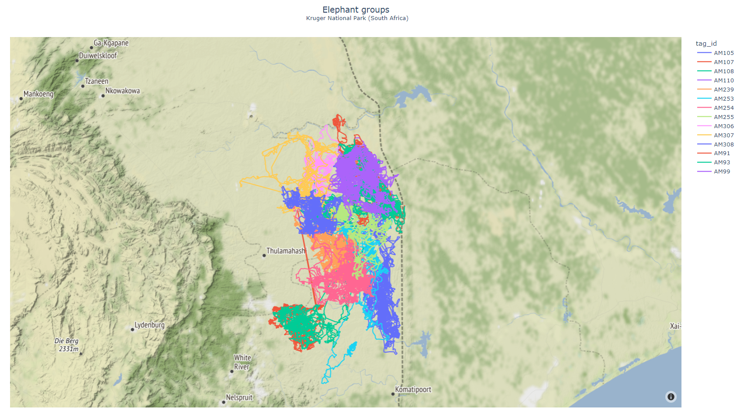


A quick demo

Slide 5
Our solution
A developed and well-trained AI-product
Supported by TWO Machine Learning models
Location tracking and visualization of the elephants
Based on accurate and scientific data
Notes:
Vision: Apply real time data to our ML-models
To predict future movement
Easily scalable and applicable to other animal species*
Or other industries, e.g. Finance or weather forecasting

Slide 6
Short demonstration
Groundbreaking AI/ML-models
DBSCAN clustering model
VARMA forecasting model

Slide 7
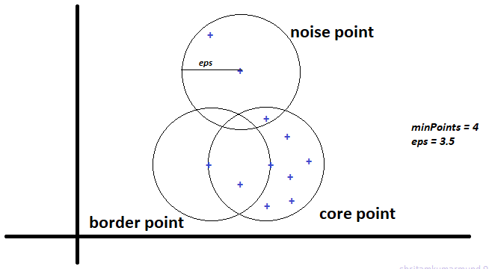
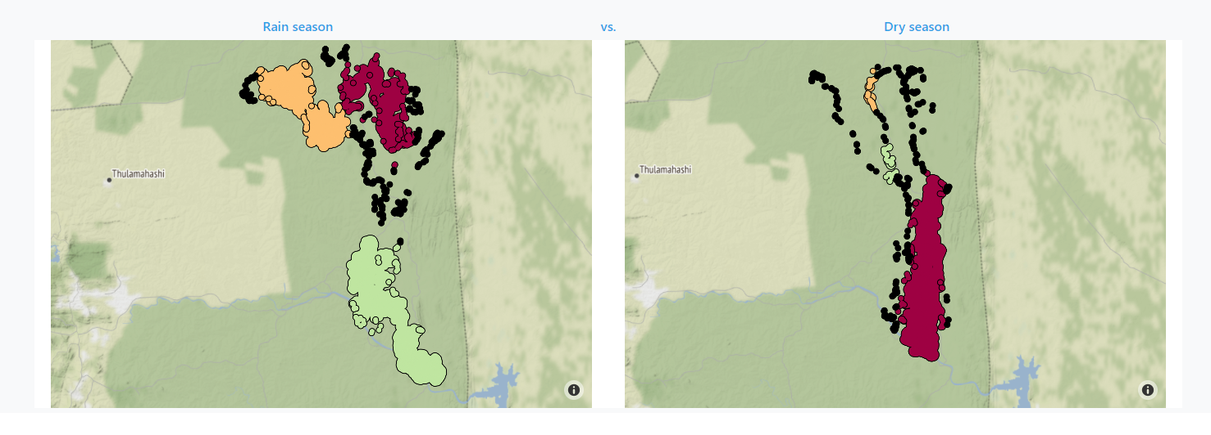
DBSCAN
Density-based spatial clustering of applications with noise
Three important concepts:
Core point
Border point
Noise point

Slide 8
VARMA Forecasting
Vector AutoRegressive Moving Average (Available in the statsmodels package)
Vector – latitude, longitude (and temperature)
Autoregressive – line fitting
Moving Average – randomness
2
1
1
3
4
5

Slide 9
Work process
Agile-ish
Stand-up + backlog + reviews
Re-prioritize tasks and goals
No strict roles

Slide 10
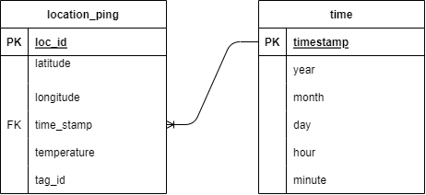
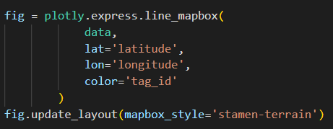
Challenges
Geographic plots
Time and date in dataset
Storage
Modelling

Slide 11
Future plans & Alternatives
Expand to other species
Alternatives:
Finance forecast
Weather forecast
Traffic behaviours
And many more..

Slide 12
References
GitHub:
https://github.com/stefanlilja/pink_elephants.git
Dataset:
https://www.datarepository.movebank.org/handle/10255/move.981
DBSCAN:
https://shritam.medium.com/how-dbscan-algorithm-works-2b5bef80fb3
VARMA:
https://www.statsmodels.org/dev/examples/notebooks/generated/statespace_varmax.html

Slide 13

Q&A

